Slide 1
Hadoop Lab – Instructions
DS Lab – CSE 3261

Slide 2
Hadoop can be installed in your systems in three different modes:
Local Standalone mode
Pseudo distributed mode
Fully distributed mode
2
Big Image Data Processing on Hadoop
03/31/23
Notes:
2
Now it is my privilege to present before you brief presentation about the department and detailed presentation for evaluating B Tech porgram in CSE in line with e-sar application submitted to NBA.
2

Slide 3
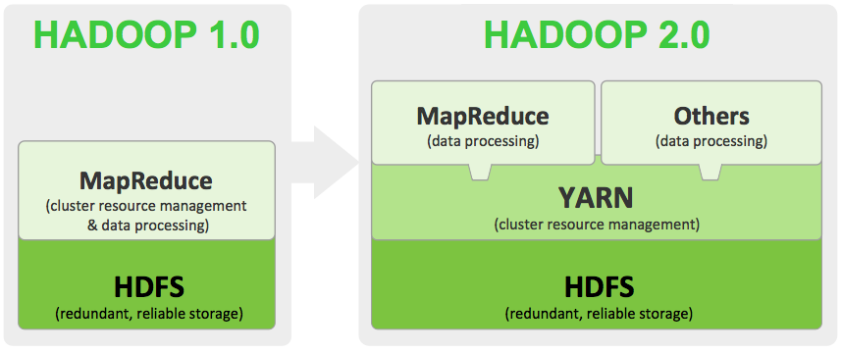
3
Big Image Data Processing on Hadoop
03/31/23
Notes:
3
Now it is my privilege to present before you brief presentation about the department and detailed presentation for evaluating B Tech porgram in CSE in line with e-sar application submitted to NBA.
3

Slide 4
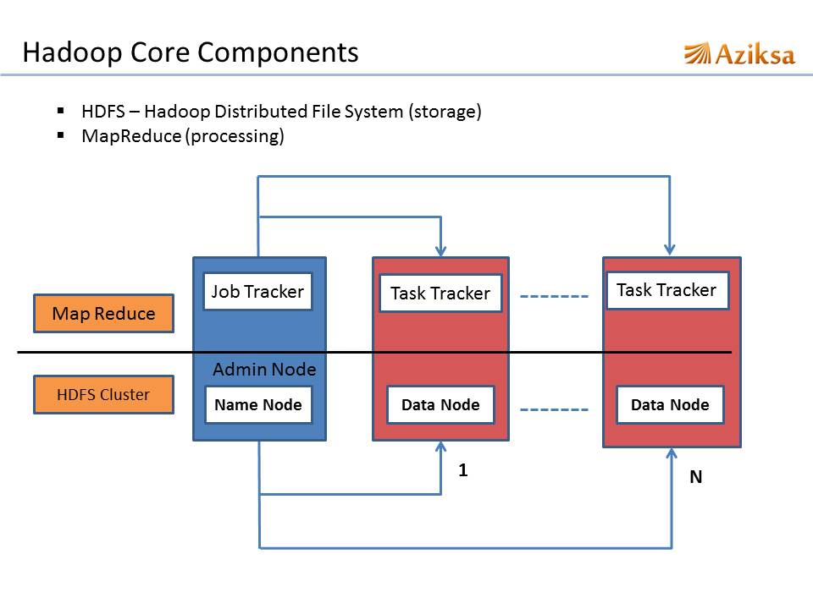
4
Big Image Data Processing on Hadoop
03/31/23
Notes:
4
Now it is my privilege to present before you brief presentation about the department and detailed presentation for evaluating B Tech porgram in CSE in line with e-sar application submitted to NBA.
4

Slide 5
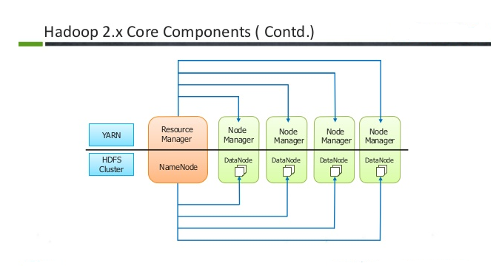
5
Big Imcetge Data Processing on Hadoop
03/31/23
Notes:
5
Now it is my privilege to present before you brief presentation about the department and detailed presentation for evaluating B Tech porgram in CSE in line with e-sar application submitted to NBA.
5

Slide 6
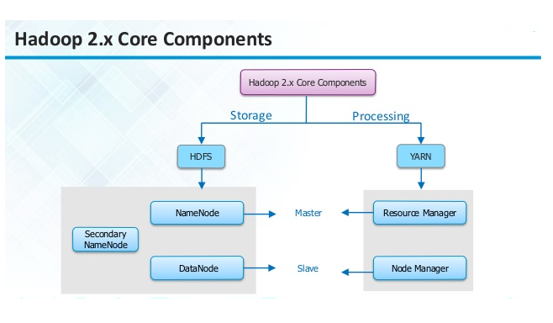
6
Big Image Data Processing on Hadoop
03/31/23
Notes:
6
Now it is my privilege to present before you brief presentation about the department and detailed presentation for evaluating B Tech porgram in CSE in line with e-sar application submitted to NBA.
6

Slide 7
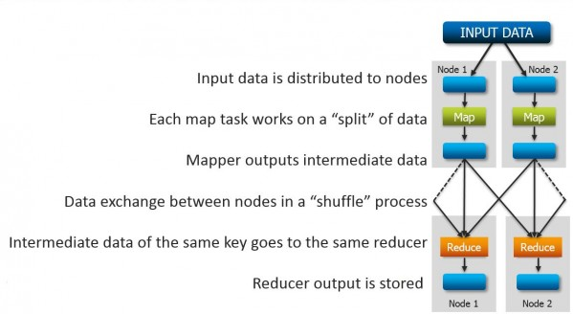
7
Big Image Data Processing on Hadoop
03/31/23
Notes:
7
Now it is my privilege to present before you brief presentation about the department and detailed presentation for evaluating B Tech porgram in CSE in line with e-sar application submitted to NBA.
7

Slide 8
Local Standalone mode:
This is the default mode. In this mode, all the components of Hadoop, such as NameNode, DataNode, JobTracker and TaskTracker, run on a single Java process.
8
Big Image Data Processing on Hadoop
03/31/23
Notes:
8
Now it is my privilege to present before you brief presentation about the department and detailed presentation for evaluating B Tech porgram in CSE in line with e-sar application submitted to NBA.
8

Slide 9
Pseudo-distributed mode:
In this mode, a separate JVM is spawned for each of the Hadoop components and they communicate across network sockets, effectively giving a fully functioning minicluster on a single host.
9
Big Image Data Processing on Hadoop
03/31/23
Notes:
9
Now it is my privilege to present before you brief presentation about the department and detailed presentation for evaluating B Tech porgram in CSE in line with e-sar application submitted to NBA.
9

Slide 10
Fully Distributed mode:
In this mode, Hadoop is spread across multiple machines, some of which will be general-purpose workers and others will be dedicated hosts for components, such as NameNode and JobTracker.
10
Big Image Data Processing on Hadoop
03/31/23
Notes:
10
Now it is my privilege to present before you brief presentation about the department and detailed presentation for evaluating B Tech porgram in CSE in line with e-sar application submitted to NBA.
10

Slide 11
SSH Setup and Key Generation in Ubuntu:
SSH setup is required to do different operations on a cluster such as starting, stopping, distributed daemon shell operations. To authenticate different users of Hadoop, it is required to provide public/private key pair for a Hadoop user and share it with different users.
11
Big Image Data Processing on Hadoop
03/31/23
Notes:
11
Now it is my privilege to present before you brief presentation about the department and detailed presentation for evaluating B Tech porgram in CSE in line with e-sar application submitted to NBA.
11

Slide 12
We run a program on Hadoop from the already existing examples given.
Let's have an input directory where we will push a few files and our requirement is to count the total number of words in those files. To calculate the total number of words, we do not need to write our MapReduce, provided the .jar file contains the implementation for word count. You can try other examples using the same .jar file; just issue the following commands to check supported MapReduce functional programs by hadoop-mapreduce-examples-3.3.4.jar file.
12
Big Image Data Processing on Hadoop
03/31/23
Notes:
12
Now it is my privilege to present before you brief presentation about the department and detailed presentation for evaluating B Tech porgram in CSE in line with e-sar application submitted to NBA.
12

Slide 13
Word-count Program execution
in HDFS Environment
When you have installed in Standalone mode, the data that you have used to run the program is from local file system.
But now, in Pseudo Distributed mode, we will be seeing how to put the data into HDFS and get the data from HDFS, so that we will have the feeling of working on Hadoop(storage).
13
Big Image Data Processing on Hadoop
03/31/23
Notes:
13
Now it is my privilege to present before you brief presentation about the department and detailed presentation for evaluating B Tech porgram in CSE in line with e-sar application submitted to NBA.
13

Slide 14
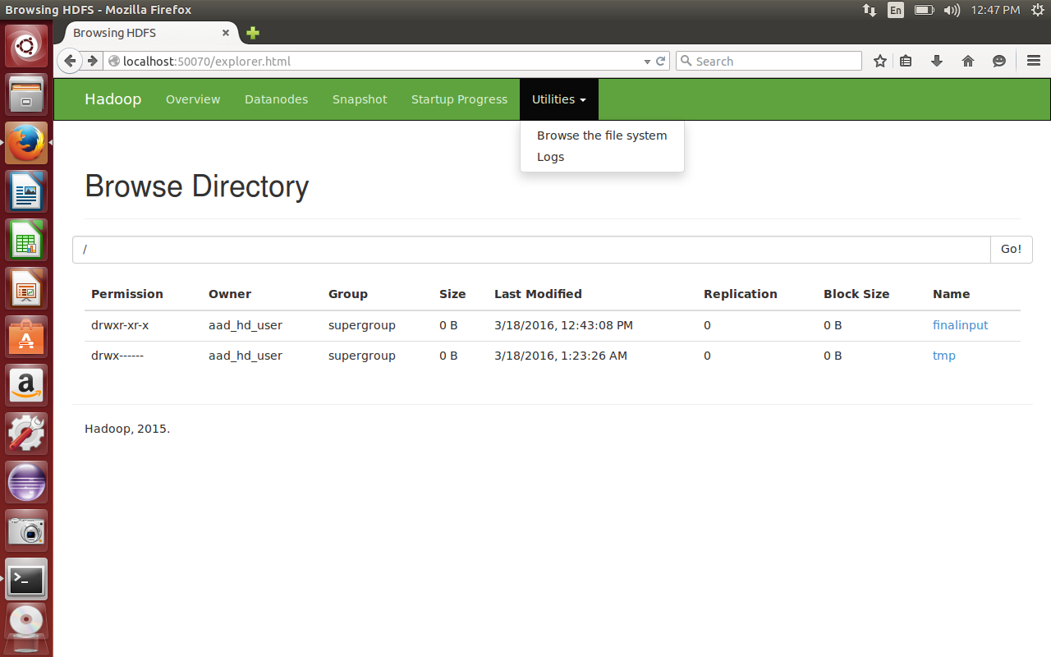
14
Big Image Data Processing on Hadoop
03/31/23
Notes:
14
Now it is my privilege to present before you brief presentation about the department and detailed presentation for evaluating B Tech porgram in CSE in line with e-sar application submitted to NBA.
14

Slide 15
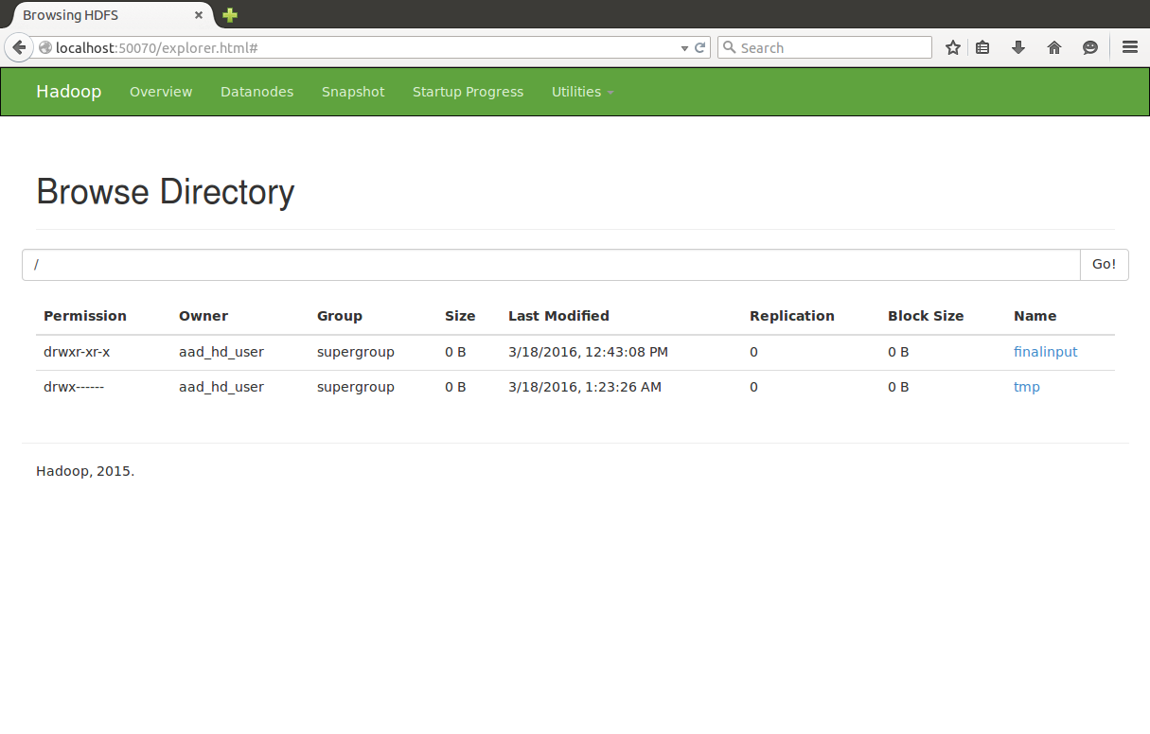
15
Big Image Data Processing on Hadoop
03/31/23
Notes:
15
Now it is my privilege to present before you brief presentation about the department and detailed presentation for evaluating B Tech porgram in CSE in line with e-sar application submitted to NBA.
15

Slide 16
Now, use the following command to execute the program
$ hadoop jar hadoop-mapreduce-examples-3.3.4.jar wordcount hdfs://localhost:9000/mictinput hdfs://localhost:9000/mictoutput
Jar file name in the current directory
This is keyword just like java
This is output directory
This is input directory
This is the file name
16
Big Image Data Processing on Hadoop
03/31/23
Notes:
16
Now it is my privilege to present before you brief presentation about the department and detailed presentation for evaluating B Tech porgram in CSE in line with e-sar application submitted to NBA.
16

Slide 17

Step-14: To see the output
$ hdfs dfs –cat hdfs://localhost:9000/mictoutput/part-r-00000
17
Big Image Data Processing on Hadoop
03/31/23
Notes:
17
Now it is my privilege to present before you brief presentation about the department and detailed presentation for evaluating B Tech porgram in CSE in line with e-sar application submitted to NBA.
17

